Slide 1
Artificial Intelligence and Machine Learning in Finance
Assistant Professor: Dionisios N. Sotiropoulos

Slide 2
Presentation Outline
Introduction to AI, Machine Learning, Deep Learning, and Data Science
Machine Learning in Finance
Key Financial Applications of Machine Learning
Types of Machine Learning
Natural Language Processing (NLP) in Finance
Computational Tools and Python Libraries
Course Structure and Assessment
Bibliography and Resources

Slide 3
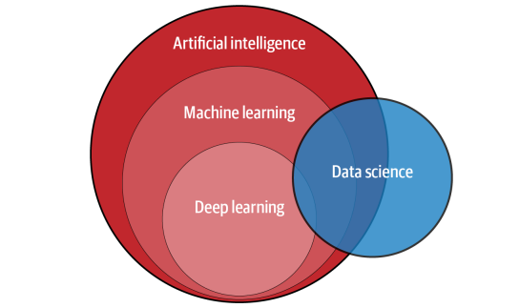
Machine Learning, Deep Learning, Artificial Intelligence, and Data Science

Slide 4
Artificial intelligence
Artificial Intelligence is a branch of computer science focused on developing systems that emulate human cognitive functions—learning, reasoning, and problem-solving—to tackle complex tasks.
These tasks include, but are not limited to:
visual perception,
speech recognition,
decision making,
translation between languages.
By leveraging advanced algorithms and vast datasets, AI enables machines to recognize patterns, make decisions, and adapt in real time—capabilities that are transforming financial services through enhanced efficiency, risk management, and innovation.

Slide 5
Machine learning
Machine learning is a subset of AI that enables systems to learn from data and improve decisions. It uses various algorithms to analyze data, identify patterns, and optimize actions.

Slide 6
Deep learning
Deep learning is a branch of machine learning that uses artificial neural networks with many layers to automatically learn complex patterns and representations from large amounts of data. Inspired by the human brain’s structure, deep learning models excel at tasks like image recognition, natural language processing, and speech understanding, without the need for manual feature engineering.

Slide 7
Data science
Data Science is an interdisciplinary field that uses scientific methods, statistical techniques, and computational tools to extract insights and knowledge from structured and unstructured data, facilitating informed decision-making and problem-solving.

Slide 8
Introduction to Machine Learning in Finance
Machine learning revolutionizes finance across hedge funds, banks, and fintech by harnessing big data and powerful computing to enhance decisions and efficiency.
As ML methods evolve, they drive major changes in financial services.
This presentation examines current and future ML applications, highlighting how they reshape the industry.

Slide 9
Importance and Adoption of Machine Learning in Finance
Financial institutions are investing in machine learning to process large datasets and make real-time decisions. ML is now essential in areas like trading, portfolio management, fraud detection, and risk management.
As finance evolves, adopting ML is key to staying competitive, driving demand for skilled experts in the field.

Slide 10
Current and Future Machine Learning Applications in Finance
Algorithmic Trading
Portfolio Management and Robo-Advisors
Fraud Detection
Loans/Credit Card/Insurance Underwriting
Automation and Chatbots
Risk Management
Asset Price Prediction
Derivative Pricing
Sentiment Analysis
Trade Settlement
Money Laundering

Slide 11
Algorithmic Trading
Algorithmic trading uses preprogrammed instructions to execute trades automatically. Machine learning enhances it by adapting strategies in real-time and identifying market patterns, giving institutions a competitive edge.
As ML evolves, its role in trading will grow, driving innovation and efficiency in financial markets.

Slide 12
Portfolio Management and Robo-Advisors
AI-driven robo-advisors manage portfolios based on user goals and risk tolerance, automatically adjusting to market changes.
Using historical data and machine learning, they optimize investment strategies, making financial planning more personalized, efficient, and accessible.

Slide 13
Fraud Detection
Machine learning is essential for fighting financial fraud by scanning large datasets to detect suspicious activities in real time. Unlike traditional systems, ML continuously learns and adapts to new threats, offering stronger and more flexible fraud detection as digital transactions grow.

Slide 14
Loans, Credit Card, and Insurance Underwriting
Machine learning in underwriting analyzes consumer data to predict lending and insurance risks. By spotting patterns in large datasets, ML improves the accuracy and efficiency of risk assessments, streamlining decision-making and enhancing financial services.

Slide 15
Automation and Chatbots
Machine learning-powered automation helps finance teams handle routine tasks and analyze data. AI chatbots improve customer service, boosting efficiency and reducing errors. Together, these tools streamline operations, cut costs, and enhance customer experiences in financial services.

Slide 16
Risk Management
Machine learning-powered automation helps finance teams handle routine tasks and analyze data. AI chatbots improve customer service, boosting efficiency and reducing errors. Together, these tools streamline operations, cut costs, and enhance customer experiences in financial services.

Slide 17
Asset Price Prediction
Machine learning enhances asset price prediction by analyzing past data and market trends. Its advanced algorithms uncover patterns traditional methods may miss, helping financial institutions make better investment decisions and optimize portfolios.

Slide 18
Derivative Pricing
Machine learning simplifies derivative pricing by reducing assumptions and directly estimating price relationships. It offers faster, more accurate models that adapt to real-world complexities, improving the efficiency and precision of pricing financial instruments.

Slide 19
Sentiment Analysis
Sentiment analysis uses machine learning to interpret data from news and social media, helping predict market trends. By analyzing sentiment, ML provides insights into investor behavior and market movements, supporting better investment decisions and deeper understanding of market dynamics.

Slide 20
Trade Settlement
Machine learning streamlines trade settlement by identifying causes of failed trades and predicting issues. By analyzing trade data, it offers insights to prevent failures, reducing manual effort and improving transaction efficiency and reliability.

Slide 21
Money Laundering Detection
Machine learning detects money laundering by analyzing data and spotting suspicious patterns. It adapts to evolving threats, strengthening financial security and compliance. ML is essential for protecting financial systems and meeting regulatory requirements.

Slide 22
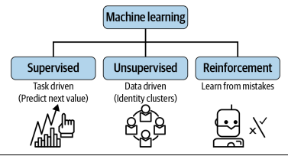
Types of Machine Learning

Slide 23
Types of Machine Learning
Machine learning encompasses:
supervised learning,
unsupervised learning,
reinforcement learning.
Each type has specific applications in finance, from predictive modeling to pattern recognition.
Supervised learning involves training models on labeled data, while unsupervised learning identifies hidden patterns in unlabeled data. Reinforcement learning focuses on learning from experiences to maximize rewards.
Understanding these different types of machine learning is essential for leveraging their potential in various financial applications.

Slide 24
Supervised Learning
Supervised learning uses labeled data to train models for predictions. Techniques like classification and regression help forecast market trends and customer behavior. In finance, it’s key for credit scoring, fraud detection, and investment analysis, improving decision-making.

Slide 25
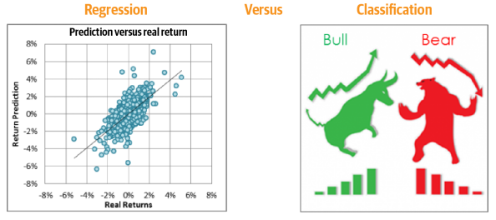
Regression vs Classification

Slide 26
Unsupervised Learning
Unsupervised learning analyzes unlabeled data to find hidden patterns. Techniques like clustering and dimensionality reduction help with market segmentation and risk analysis. In finance, it’s vital for customer segmentation, anomaly detection, and portfolio optimization.

Slide 27
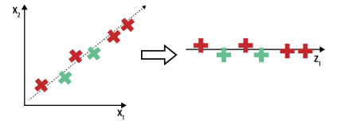
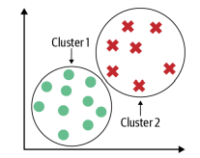
Unsupervised Learning
Dimensionality Reduction
Clustering

Slide 28
Reinforcement Learning
Reinforcement learning learns from experience to maximize rewards. It’s used in dynamic environments like trading, adapting to new information. In finance, it helps optimize decisions in algorithmic trading, portfolio management, and risk management.

Slide 29
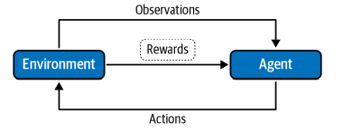
Reinforcement Learning

Slide 30
Natural Language Processing (NLP)
Natural Language Processing (NLP) enables machines to understand human language for tasks like sentiment analysis, chatbots, and document processing. In finance, NLP helps analyze reports, news, and customer interactions, offering insights into market trends and improving decision-making.

Slide 31
Course Description I
This course focuses on developing computational techniques of machine learning (ML) and data science (DS) with a focus on financial applications. Covering supervised, unsupervised and reinforcement learning we will learn to implement real-world financial models using Python.

Slide 32
Course Description II
The course emphasizes hands-on coding and case studies related to (depending on the pace of the lectures):
Stock Market Prediction with Deep Neural Networks
Derivative Pricing
Investor Risk Tolerance and Robo-Advisors
Bitcoin Trading Strategy
Portfolio Management: Clustering Investors
Reinforcement Learning-Based Trading Strategy

Slide 33
Python Modules and Libraries I
Core Scientific and Data Manipulation Libraries
NumPy: Numerical operations and array handling.
Pandas: Data manipulation and analysis, handling financial time series and tabular data.
Matplotlib: Visualization of financial data and model results.
SciPy: Advanced mathematical functions and scientific computations.
Seaborn: Advanced data visualization, built on top of Matplotlib.

Slide 34
Python Modules and Libraries II
Machine Learning
Scikit-learn (sklearn):
Classical ML algorithms (regression, classification, clustering, dimensionality reduction).
Model evaluation tools (cross-validation, metrics).
Reinforcement Learning and Simulation
OpenAI Gym: Reinforcement learning environments for financial trading simulations.
Policy Gradient & Q-learning: Custom implementations for reinforcement learning models applied to finance.

Slide 35
Python Modules and Libraries III
Deep Learning and Neural Networks
Keras:
A high-level API for building and training neural networks, running on top of deep learning backends like TensorFlow (implicitly).
Simplifies neural network creation with a focus on rapid prototyping and ease of use.
Suitable for beginners and fast experimentation in finance-related deep learning tasks.
PyTorch:
A flexible and widely used deep learning library developed by Facebook AI Research (FAIR).
Known for its dynamic computation graph, intuitive design, and strong GPU support, making it highly effective for research and production.
Popular in the financial sector for time series forecasting, reinforcement learning for trading, and NLP applications like sentiment analysis.

Slide 36
Course Assessment
Assessment Method:
The course will be assessed exclusively through a computational project.
Project Scope:
Students will apply machine learning and data science techniques to a real-world financial problem.
Projects may include algorithmic trading strategies, risk models, portfolio optimization, robo-advisors, or NLP applications in finance.
Group Work:
Students are encouraged to work in groups of up to 3 members.
Individual work is also allowed.
Deliverables:
Final report detailing the methodology, results, and analysis.
Python code implementing the solution.
Presentation (Perhaps oral) of key findings and outcomes.

Slide 37
Bibliography
Hariom Tatsat, Sahil Puri , Brad Lookabaugh, Machine Learning and Data Science Blueprints for Finance: From Building Trading Strategies to Robo-Advisors Using Python, O'Reilly Media, 2020

